Slide 1

The GitHub map
A
Z
Ali Karooni & Lucas Bergeron
Notes:
The GitHub map from A to Z

Slide 2
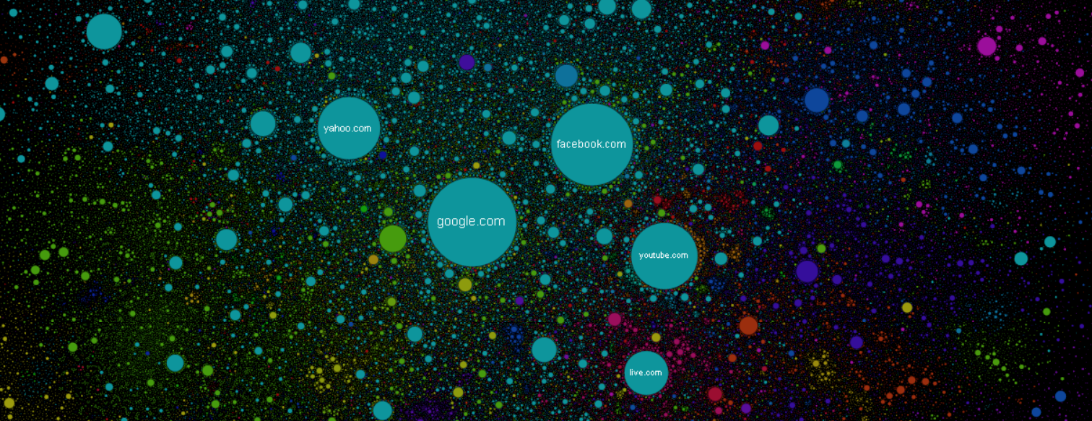
The internet map
Notes:
Inspired from the internet map : https://internet-map.net/
There is no X or Y axis but an algorithme using attraction and repulsion,

Slide 3
Our objectives
4
0.5
f
2
Page ranking
Plotting
400 000 repos
All users contributing to those repos
A
d
0.1
0.5
h
1
c
D
C
a
1.5
1.5
b
g
1
1
e
1
1
B
UPPERCASE = Repo
lowercase = User
Number = Weight (proceed with pagerank)
K
0.5

Slide 4
The database
Links
User
Repo
email
name
email
name
name
…
weight
weight
commits

Slide 5
How does the page ranking algorithm works ?
a
A
6
2
b
1
c
3
4
B

Slide 6
How does the page ranking algorithm works ?
a
1/5
A
1/5
< 6/9
6/6 >
< 1/9
< 2/6
1/4 >
2/9 >
b
1/5
c
1/5
< 3/7
< 4/6
3/4 >
4/7 >
B
1/5

Slide 7
How does the page ranking algorithm works ?
a
0.2
A
0.2
< 67%
100% >
< 11%
< 33%
25% >
22% >
b
0.2
c
0.2
< 43%
< 67%
57% >
75% >
B
0.2

Slide 8
How does the page ranking algorithm works ?
1
0.2
A
0.2
< 67%
100% >
< 11%
< 33%
0.134
25% >
0.316
22% >
3
0.2
4
0.2
< 43%
< 67%
0.108
57% >
0.158
75% >
B
0.2
0.284
Notes:
https://towardsdatascience.com/graphs-and-paths-pagerank-54f180a1aa0a

Slide 9
Page ranking problem
c
0.25
c
0.0833
< 100%
< 100%
33.33% >
33.33% >
a
0.25
A
0.25
a
0.0833
A
0.75
< 33.33%
< 33.33%
100% >
100% >
< 100%
< 100%
33.33% >
33.33% >
b
0.25
b
0.0833
Notes:
https://www.youtube.com/watch?v=EvVPoDMDTM8&t=34s

Slide 10
Final results
A
Z
Notes:
The GitHub map from A to Z

Slide 11
Page ranking - Top 10 GitHub
Repositories
Repo 1
Repo 2
Repo 3
Repo 4
Repo 5
Repo 6
Repo 7
Repo 8
Repo 9
Repo 10
Users
User 1
User 2
User 3
User 4
User 5
User 6
User 7
User 8
User 9
User 10

Slide 12
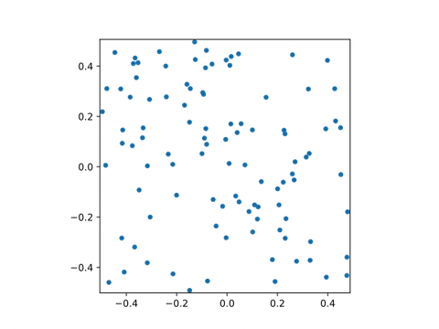
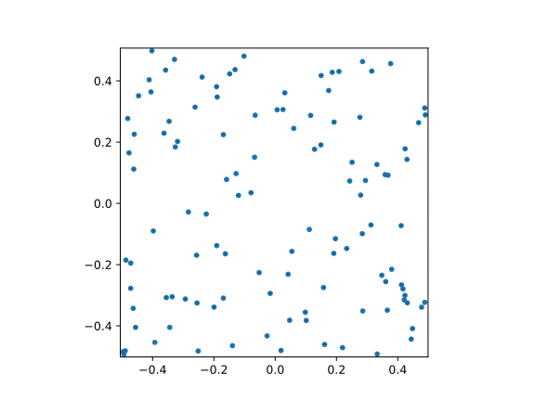
Ploting result –The GitHub-map
2 repositories (A & B) with 50 contributors each.
26 repositories (A to Z) with 500 contributors and random contributions.

Slide 13
Thank you !
A
Z
Ali Karooni & Lucas Bergeron
Notes:
Thanks a lot for your attention, from A to Z ;)

